Slide 1

Fuzzy Inference Systems

Slide 2
Fuzzy Systems
The concepts of soft computing that we introduced in Chapter 1 form the guiding principles of fuzzy logic.
With fuzzy logic, the system is made to give the most probable output to any kind of input based on the predefined rules.
Other interesting use of fuzzy systems is in classification and pattern recognition problems, where they are able to easily determine the output class that the input corresponds to.
Fuzzy systems get their name from the uncertainty or probability they associate with the various stages of functioning as they calculate the outputs from the applied inputs.
Fuzzy systems are entirely rule driven. Mapping of the inputs and outputs is accomplished by the rules, which are specified during the design.

Slide 3
Historical Note
The history of fuzzy logic goes back to the days of Aristotle and the binary logic representing true and false, which began the development of logic in the history of humankind.
Multilogic also evolved about the same time, but not to a very good extent.
The field attracted the attention of numerous researchers worldwide and initiated a great deal of work in this field.
Fuzzy logic then joined the application domain, where it has been used in numerous systems and consumer applications, including washing machines, camcorders, and microwave ovens, to name just a few.

Slide 4
Fuzzy Logic
Logic
Every mapping of the inputs to the outputs is done using a set of guidelines, or functions, that are the inherent properties of the system being considered.
This knowledge removes the gap between human an machine understanding.
We also defined knowledge as “a function that maps a domain of clauses onto a range of clauses.
The function may take algebraic or relational form depending on the type of applications” (Konar, 2000).

Slide 5
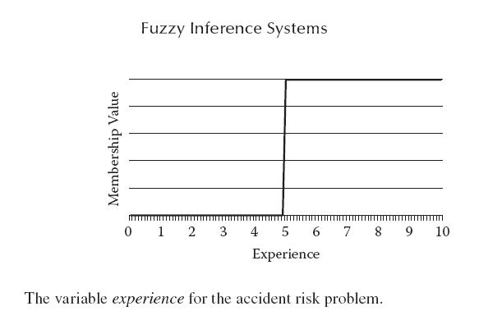
Logic
Consider the rule:
If (X marks are more than 80) & (X attendance is more than 75%), then (X grade is A).
Here the if part states all the conditions that if true lead to the action.

Slide 6
Problems with Non fuzzy Logic
This means that either the action will take place or it will not. If the condition were the set of conditions joined by logical operators, then the same concept holds true.
Once again, the various conditions are evaluated using the state of the system and are worked using the logical operators.
In the real world, however, this might not give a very realistic picture of the entire system. Consider this example:
If (driver experience is high) & (road is bad), then (accident risk is moderate).
If (driver experience is low) & (road is bad), then (accident risk is high).
If (road is good), then (accident risk is low).

Slide 7
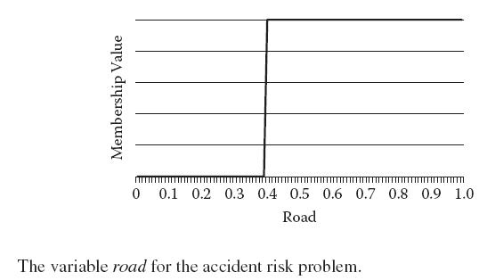
Problems with Non fuzzy Logic

Slide 8
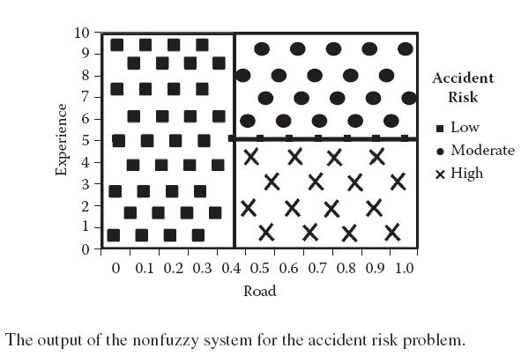
Problems with Non fuzzy Logic
Working with these rules, it may easily be seen that for a person with 5 years of experience driving on a road with road index 0.5, the accident probability is moderate (or 0.4).

Slide 9

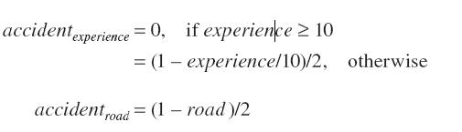
Problems with Non fuzzy Logic
The system discussed here is its very basic version and is given by Equations 4.1 through 4.3.
where accidenttotal is the total probability of an accident (output), accidentexperience is the accident probability due to experience, and accidentroad is the accident probability due to road conditions.

Slide 10
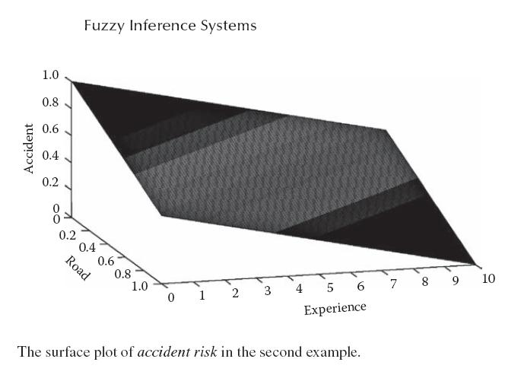
Problems with Non fuzzy Logic
In the rest of this chapter, we will see how fuzzy systems can solve these problems with better system design.

Slide 11
Fuzzy Logic
In fuzzy logic, every input belongs to every class. The degree of association of the input to the various classes varies.
This association may be very strong to some class but and weak for other classes, or the association may be moderate for all classes.
In our example of the road, we find that under fuzzy logic, experience can be high and low at the same time.
Thus the driver’s experience may be high to the extent of 80 percent and low to the extent of 10 percent.
This means the driver’s behavior closely follows the behavior of experienced drivers, but the 10 percent association indicates that this behavior to some extent follows the behavior of inexperienced drivers.
This gives good results when applied over real-life cases.

Slide 12
When Not to Use Fuzzy
In this section, we discuss some types of problems for which fuzzy logic should not be applied.
In this instance, fuzzy logic may not be the best approach. Fuzzy logic follows simple English rules that must be known for a system to have an effective design.
In the absence of these rules, the performance might be poor, or we may have to apply many efforts to study the patterns of inputs and outputs in search of the rules.
If we are to find the speed at time t, it would be better to apply the standard mathematical equation rather than fuzzy logic.
Although in the same problem, if we introduce additional constraints that mathematics finds it very difficult to cater, the problem may become fuzzy.

Slide 13


Fuzzy Sets
We have already discussed the concept of degree of membership and various classes in terms of fuzzy logic.
This may be any value greater than or equal to 0 and may be represented by Equation 4.4.
This is shown as a/b, where a denotes the element of the set and b denotes the degree of membership of a in the set.
where we assume that the degree of membership of z in the set is given by the function m(z).
Thus it is natural that the degree of membership will increase as z increases, because as experience increases, the driver will more closely follow the characteristics of an experienced driver.

Slide 14
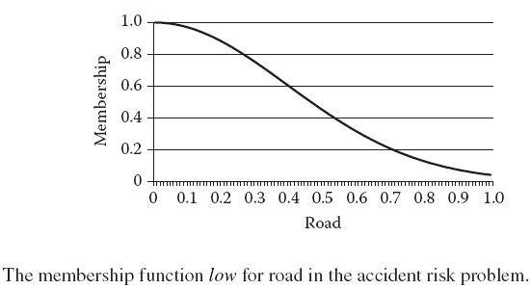
Membership Functions
Every element is denoted with a certain degree of association that is given by a function known as the membership function (MF).
The function may be denoted by m(z), where z is the element.
Any input may have one or more membership functions associated with it.
The member functions for the two classes of experience—low and high—are given in Figures 4.4b and 4.4c, respectively.

Slide 15
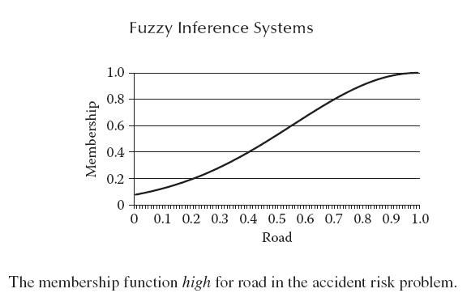
Membership Functions
MFs are defined by the system designer according to the problem. Normally designers prefer to use standard membership functions, which have been used in numerous problems.
We now discuss a few of these membership functions.

Slide 16

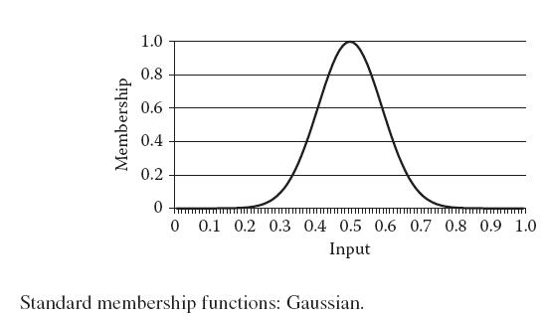
Gaussian Membership Functions
This widely used membership function denotes either a sharp Gaussian decrease or a sharp Gaussian increase in the membership value.

Slide 17
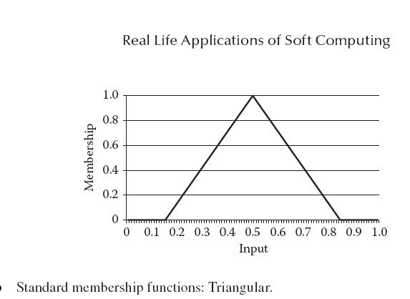
Gaussian Membership Functions

Slide 18
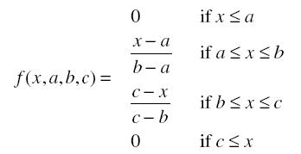
Triangular Membership Function
This function, which denotes a straight-line decrease or increase in the membership value, is used in situations where there is a simple linear degradation or up-gradation of the membership value.
From that point, the membership value starts increasing and touches a maximum of 1 when it is at point b.
It then starts decreasing until it reaches 0 at point c. From c onward the membership value is 0.

Slide 19
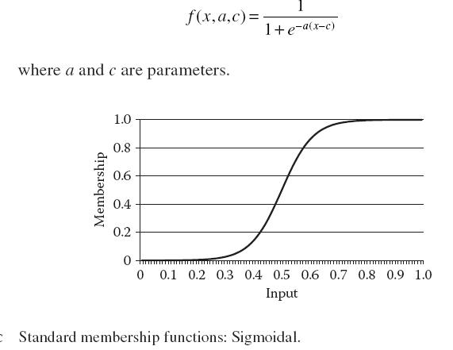
Sigmoidal Membership Function
The sigmoidal MF, which depicts the sigmoidal function, is given by

Slide 20
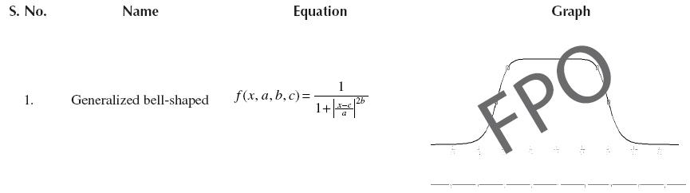
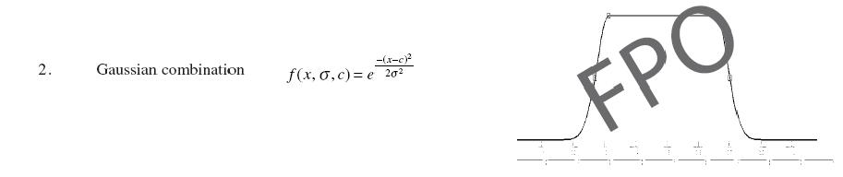
Other Membership Functions
Using MF, we can determine the degree of association of any element to any of the classes of inputs or outputs.
Commonly Used Membership Functions

Slide 21
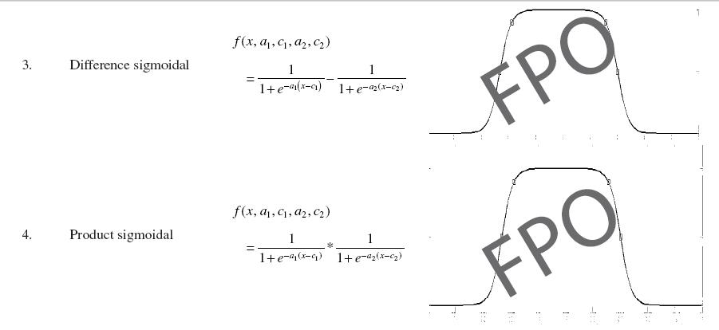
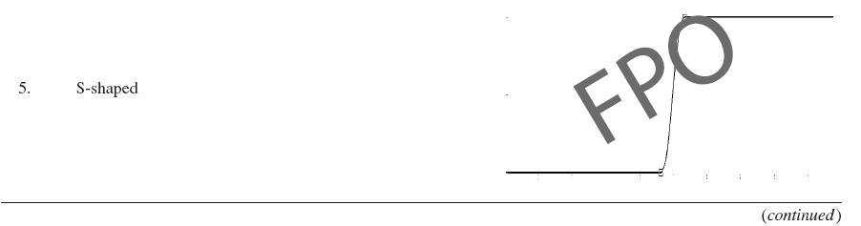
Other Membership Functions

Slide 22
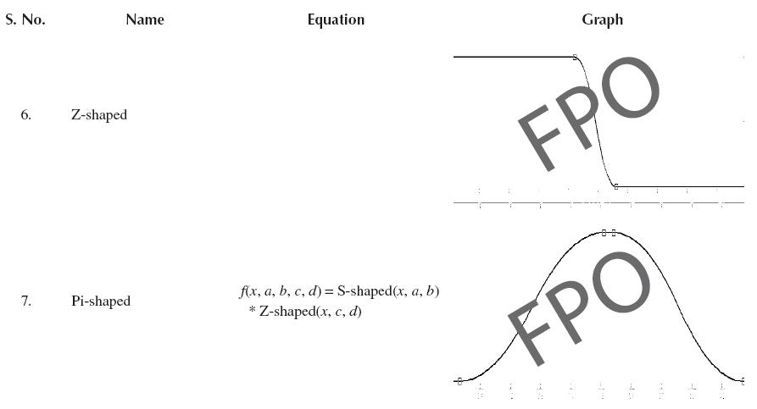
Other Membership Functions
We concentrate only on the antecedents here. Suppose the condition reads, “If driver is highly experienced.”

Slide 23

Fuzzy Logical Operators
Any condition in a rulebased approach may carry a number of logical operators.
Any operator may also be applied with a unary operator NOT.
Any condition may ultimately be represented using the generalized form given in Equation:
Various conditions joined by logical operators may be handled in a manner similar to how we handled the logical operators in Boolean algebra.
Here we have the rule of precedence, associative law, commutative law, etc.

Slide 24

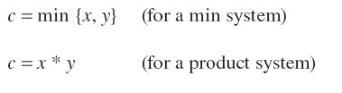
AND Operator
AND is a binary operator that takes two inputs and returns a single output. It may be represented by Equation 4.11.
In fuzzy systems, we usually take the AND operator as the min or product, both of which have their conventional meaning and are represented by Equations 4.12 and 4.13:
We take two sample graphs for the variables x and y.
The resultant graph generated by the fuzzy AND operator using both the min method and the product method are given in Figure 4.6a, while Figure 4.6 shows their binary equivalents.

Slide 25
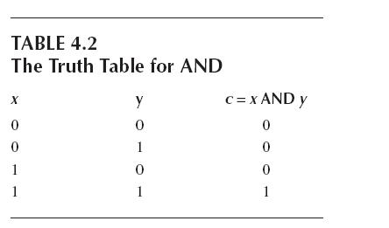
Realization of Min and Product
It may be interesting to observe the behavior of the AND operators in the inputs given in Figure 4.6.
We know that for this intrusion, an intruder must break two security doors, one after the other.
After that, the intruder may exploit the system.

Slide 26
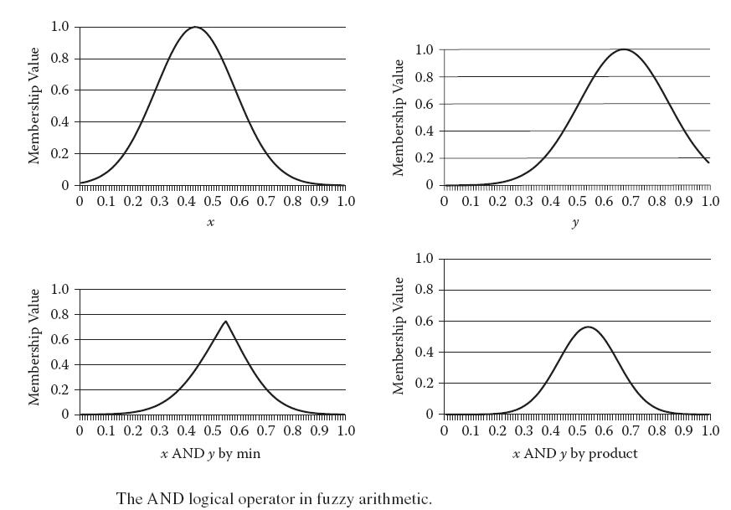
Realization of Min and Product

Slide 27
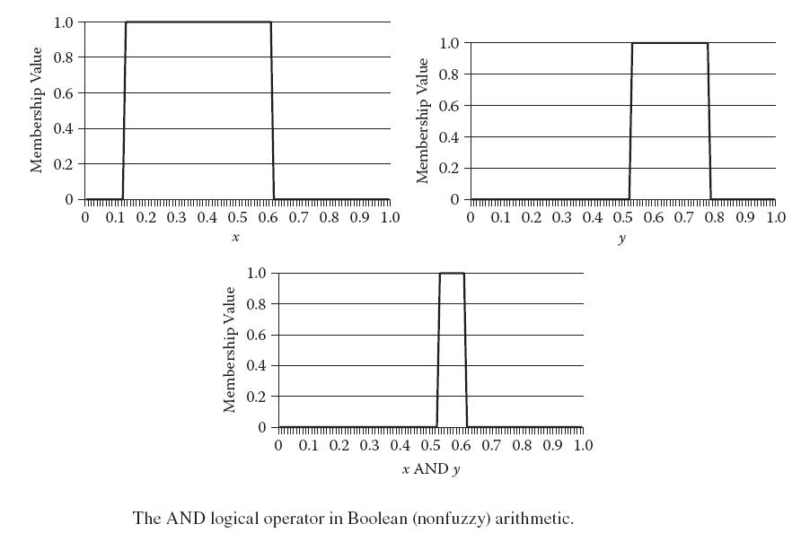
Realization of Min and Product

Slide 28
Realization of Min and Product
This sounds very similar to the use of product as the AND operator.
P(intrusion) = P(door1 is passed) * P(door2 is passed)
The comfort depends on the road condition and the vehicle condition. The general rule may be framed as, “If (vehicle condition is bad) AND (road condition is bad), then (comfort is poor).”
In such a case, it may be seen that the comfort behaves as the minimum of the two factors.
We further assume that if the person is traveling on a dirt road, it would not make any difference whether he travels by a very expensive car or a normal car, since he would not enjoy the drive in any ase.

Slide 29

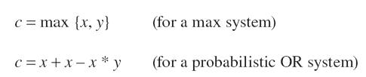
OR Operator
OR is another binary operator that takes two inputs and returns a single output. It may be represented by Equation 4.15.
In fuzzy systems, we take the OR operator as the max or the probabilistic or. Both have their conventional meaning and are represented by Equations 4.16 and 4.17.
The graphs for the OR operator are given in Figure 4.7a, while Figure 4.7b shows their binary equivalents.

Slide 30
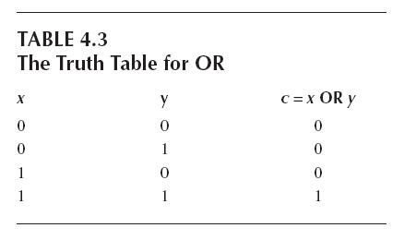
Realization of Max
Consider that the same two doors are not sequential this time, but parallel.

Slide 31
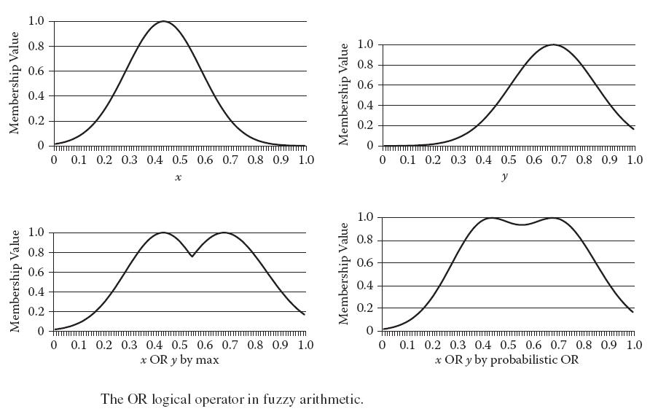
Realization of Max

Slide 32
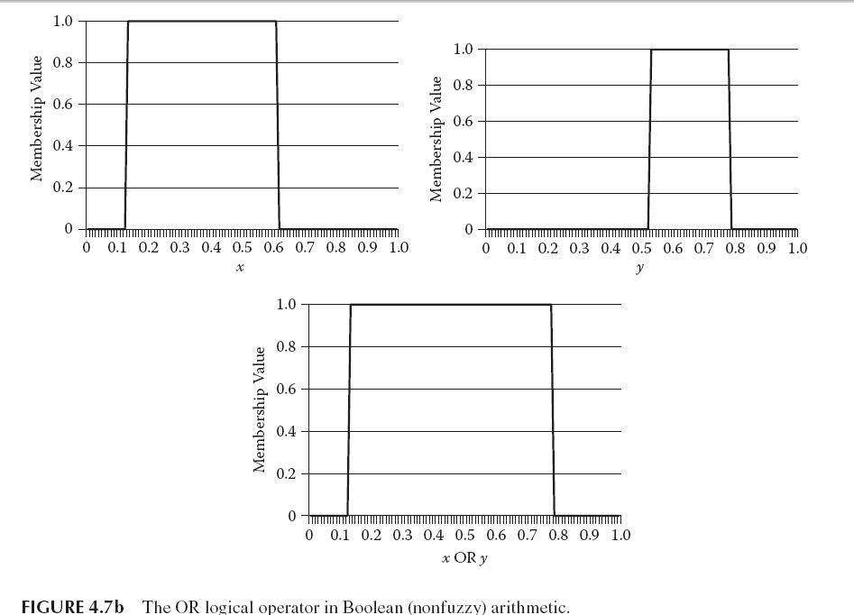
Realization of Max

Slide 33
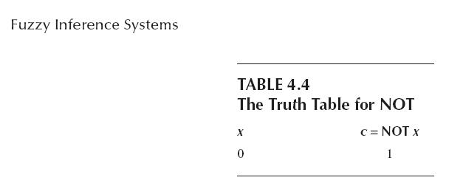
Realization of Max
In such a situation, we may write the fuzzy rule as, “If (door1 security is poor) OR (door2 security is poor), then (intrusion is high).”
He would then break the security for intrusion. This situation behaves in a similar way to the max operator.

Slide 34

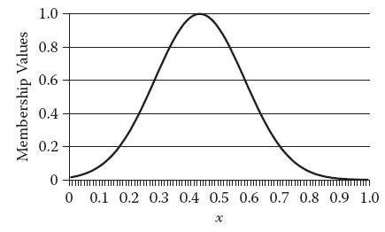
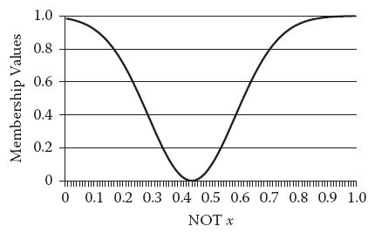

NOT Operator
NOT is a unary operator that takes one input and returns a single output.
The graphs for the OR are given in Figure 4.8a. Figure 4.8b shows their binary equivalents.

Slide 35
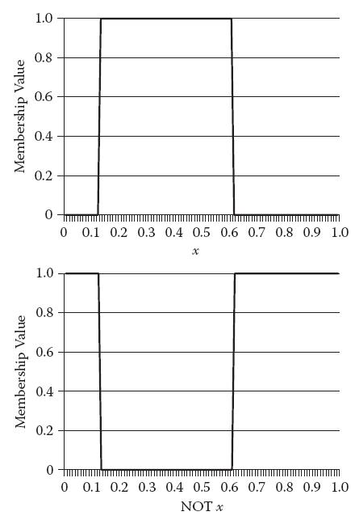
NOT Operator

Slide 36
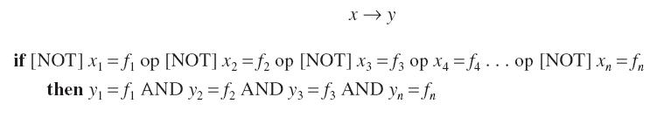
Implication
So far, we have reduced any rule to the form “if x, then y1 = c1 and y2 and c1 and y2,” or “x → y” We now resolve the THEN operator (→), which is known as the implication operator and is given by Equation 4.20.
where x1, x2, x3, . . ., xn are the input variables, fj is the membership functions, [NOT] means that its presence is optional, op stands for and/or, and y1, y2, y3, . . ., yn are the output variables.
The AND represented in the left part of the expression in Equation 4.21 is different from the one given on the right side.

Slide 37
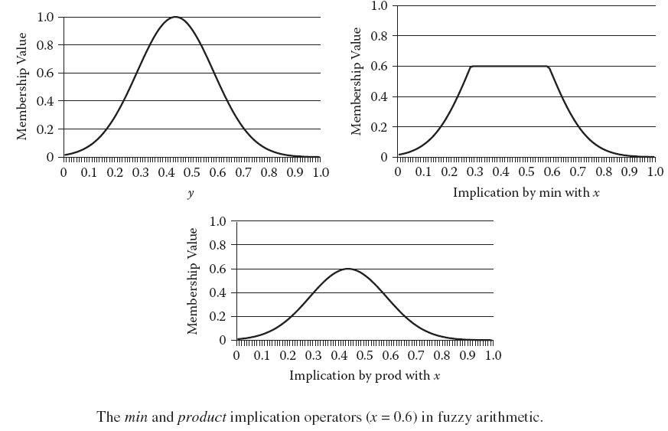
Implication

Slide 38
Implication
Unlike the AND operator, the implication function is not the combination of conditions according to the laws of the logical operators.
We know that if the condition is x → y, it means that we are trying to associate the output of the variable x by that represented by the MF y.
If we reduce the membership degree, however, the effect of this rule also reduces, which means we have an idea of the output, but we are not that sure of the output.
For this reason, we minimize the output’s membership degree.
This means we are not that sure of the accident being high.
This is exactly what the implication operator does.

Slide 39
More Operations
Aggregation
In any fuzzy system, numerous rules exist. This means by using knowledge so far, we are able to obtain a set of functions for each and every rule for every output class.
The final output is affected by each rule and by the decided membership functions.
This summation represents an MF that is the combination, or the aggregation, of the constituent MFs.
This is with regard to the property of the membership function.
The graphs for all three of the aggregation for three different rules x, y, and z are given in Figure 4.10.

Slide 40
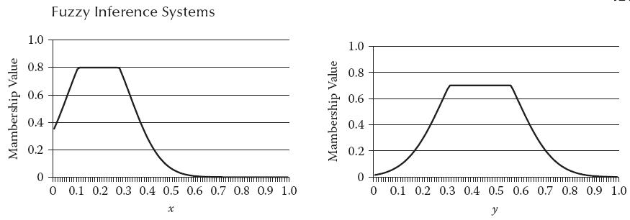
Realization of Sum and Max
In this section, we present the novelty behind the use of these functions and how they are catering to the needs of the functions for the purpose of effective fuzzy system design.
This is the voting mechanism, which works on the principles of addition.
This time it was a heterogeneous group of people with different levels of understanding.

Slide 41
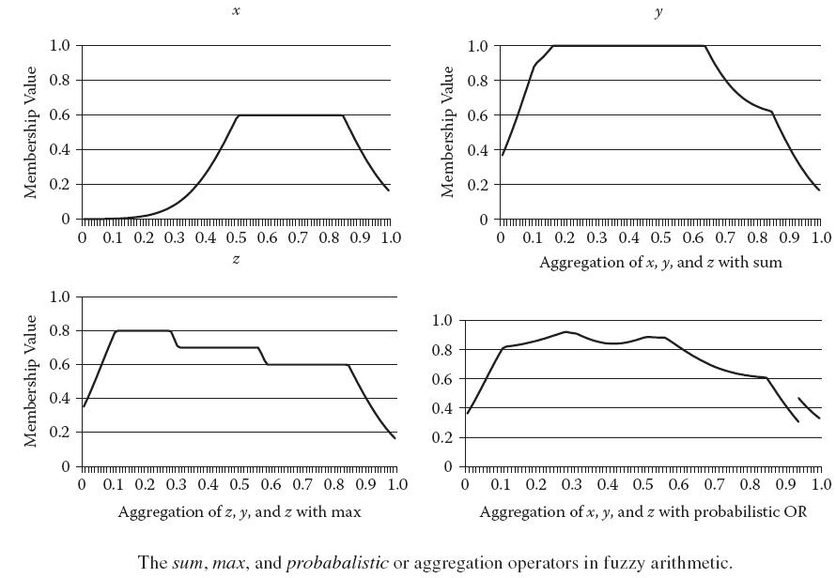
Realization of Sum and Max

Slide 42
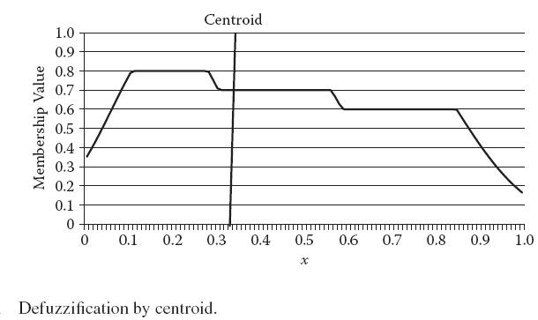
Defuzzification
Now we need to return the crisp output, or the numeral output, that the system is expected to give.
This process converts the calculated membership to a single numeric output for each output variable.
Defuzzification is applied to the obtained membership degrees to generate the crisp output.

Slide 43


Centroid:
The centroid finds the centroid of the total area represented by the membership curve.
where o is the final defuzzified output, xi is the range of values of the output variable, and mi is the corresponding membership function.
Bisector: The bisector finds the bisector of the total area represented by the membership curve.
where o is the final defuzzified output, x1 and x2 are the ranges of output, and m is the corresponding membership function.

Slide 44
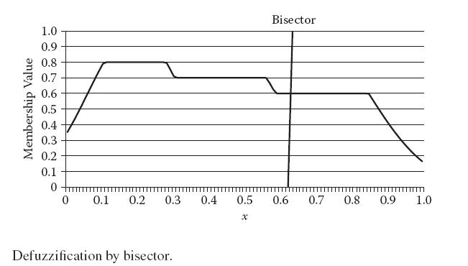
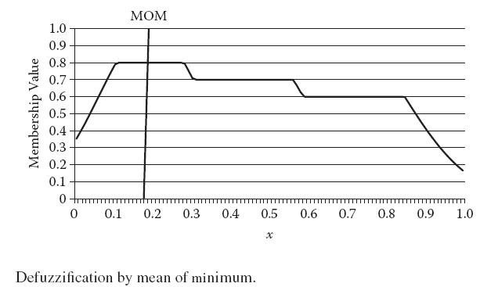
Bisector

Slide 45

Bisector
MOM: The mean of maximum is the average maximizing at which the membership function is the maximum.
where o is the final defuzzified output and x covers all values of the output range where membership is maximum.
SOM: The smallest of maximum is the smallest value of the output variable at which the membership function is the maximum.
where o is the final defuzzified output and x covers all values of the output range where membership is maximum.

Slide 46
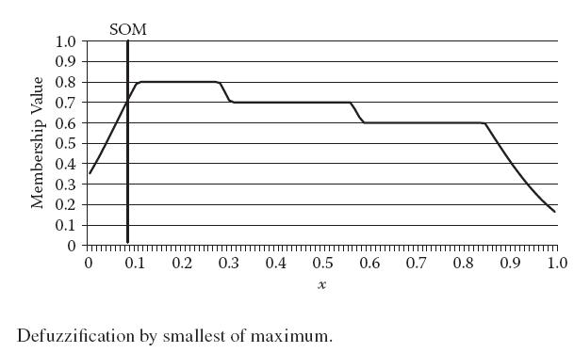
Bisector

Slide 47
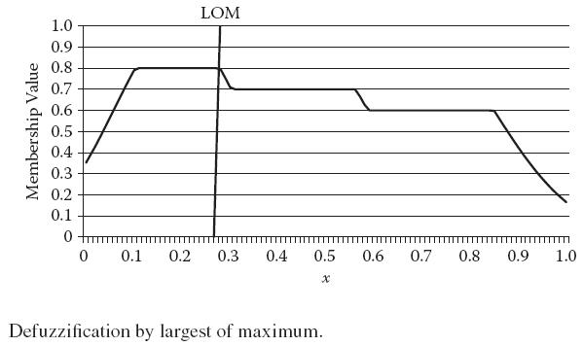

Bisector
LOM: This is same as SOM, except that we select the maximum value.
where o is the final defuzzified output and x covers all values of the output range where membership is maximum.

Slide 48
Fuzzy Inference Systems
In the previous section, we learned about the means and methods with which we can convert any general rule-based system into a fuzzy logic–based system.
In this section, we present a step-by-step approach to how the system finds the correct output to any problem.
FISs are hence good at modeling real-life problems once we know the common characteristics or the general rules of the system.
We start by discussing the general methodology and characteristics of FIS. We then provide a step-by-step guide to working with these systems.

Slide 49
Fuzzy Inference System Design
This section covers the general design principles of the fuzzy systems that so far we have been discussing in general.
We cannot take any randomly distributed data and try the fuzzy approach. Instead we must know the general guiding rules that relate the inputs to the outputs.
Along with inputs and outputs, the design consists of selecting the correct rules that relate the inputs to the outputs.
A system with defective rules will not be able to perform very well, especially in the presence of a high amount of data.
Based on this, the MF may be selected. Doing so is more of an art and experience rather than a deep knowledge of fuzzy systems.

Slide 50
The Fuzzy Process
Fuzzification:
The process starts with the fuzzification of the inputs. In this step, we calculate the value of the degree of membership for each input to each of the needed classes by using the associated membership functions.
The first denotes the membership of x to the class of high experience, or mA(x), and the second is the membership degree of y to the class of bad road, or mB(y). We can clearly see that each input is associated with some class, and the corresponding membership degree is thus found out.
Logical operations:
This membership degree is in the form of a graph or a set of values for every output, as we saw in the previous section.
In our example, implication on condition R0 would result in a graph being made for the output variable accident.

Slide 51
The Fuzzy Process
Aggregation:
Aggregation combines all rules into one. This results in the combination of the different membership graphs to generate a common membership graph.
In our example, the three rules—R0, R1, and R2—are combined to produce a common graph that will then be further processed.
Defuzzification:
Defuzzification is carried out using any of the operators we discussed in the previous sections.
It converts the graph we obtained in the aggregation step into a numeral that is given as the output. This step is done for each output variable in the system.

Slide 52
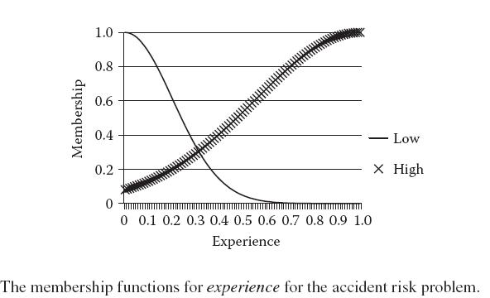
Illustrative Example
Suppose the membership functions of the two input variables experience and road and one output variable accident are as given in Figures 4.12a, 4.12b, and 4.12c, respectively.

Slide 53
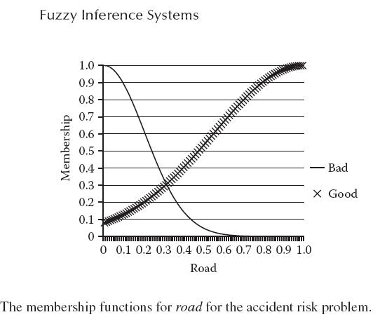
Illustrative Example

Slide 54
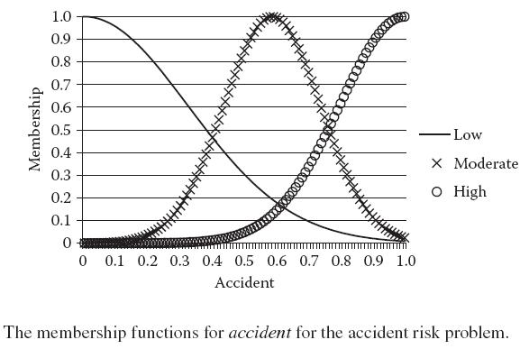
Illustrative Example

Slide 55
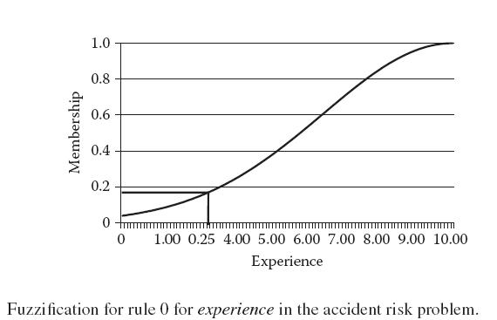
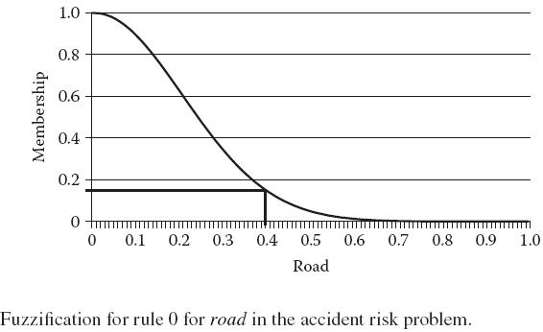
Illustrative Example

Slide 56
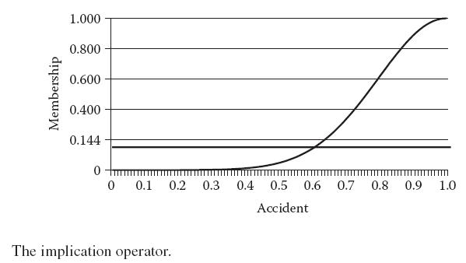
Illustrative Example
In this way, we can get the output from any set of inputs. The complete FIS system is given in Figure 4.17. It denotes the manner in which the output is mapped to the inputs.

Slide 57
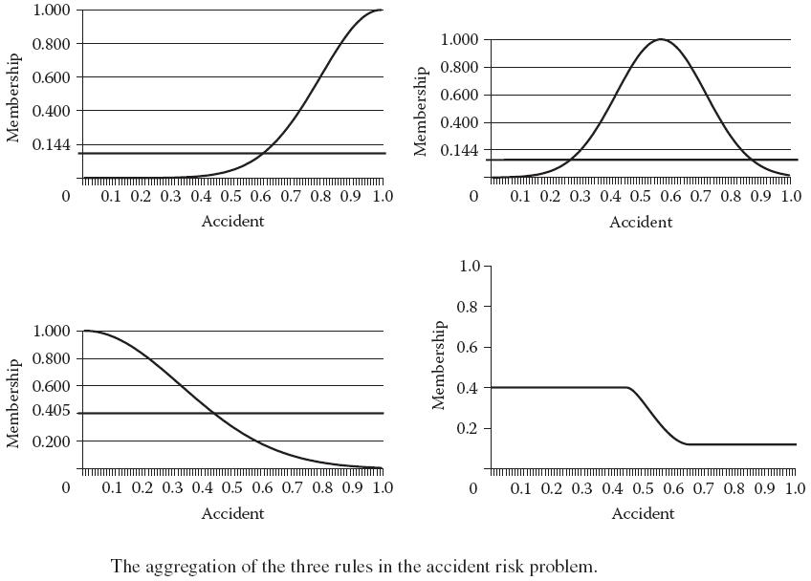
Illustrative Example

Slide 58
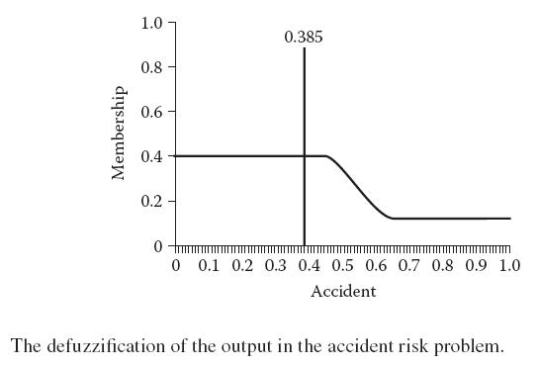
Surface Diagrams
To get a better understanding of the system and its behavior, we often use surface diagrams. A surface diagram is a multidimensional representation of the entire system.
Figure 4.18 plots the surface diagram of the road problem.

Slide 59
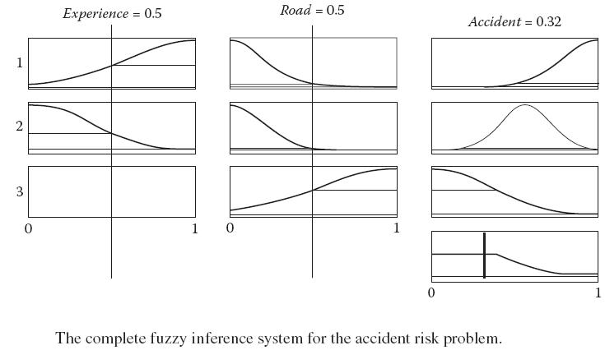
Surface Diagrams

Slide 60
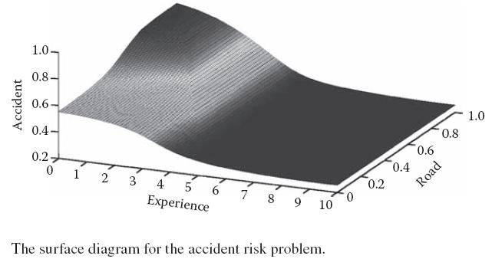
Type-2 Fuzzy Systems
T2 Fuzzy Sets:
From our discussion so far, we know that the T1 FS denotes the fuzziness or impreciseness present with any input.
Now suppose the left corner of the triangle depicted in the graph is not well known.

Slide 61
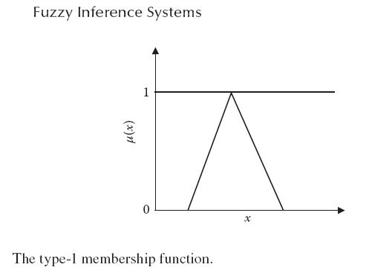
T2 Fuzzy Sets
Here the points required by the T1 FLS can lie anywhere in the associated region.
We cannot be sure of where these points will lie.

Slide 62
T2 Fuzzy Sets
The same may be seen from the membership function graph, where the membership values for the different inputs were plotted.
Because the membership function m’(x) in case of T2 FS is fuzzy, the fuzziness must have some value.
This means that u can take N values corresponding to each of these N membership functions for the corresponding x. These values may be denoted as u1 = MF1(x), u2 = MF2(x), u3 = MF3(x), . . ., uN = MFN(x).
It may hence be interpreted that the probability or membership value is equal for all points in the curve.

Slide 63
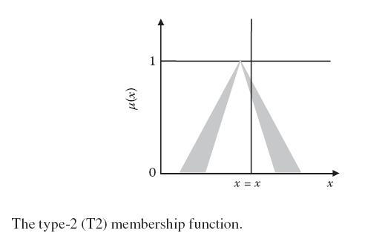
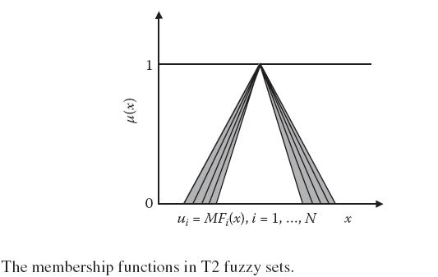
T2 Fuzzy Sets

Slide 64
T2 Fuzzy Sets
The IT2 FS is commonly used. In fact, most T2 FLS applications use IT2 FS. The latter’s underlying assumption results in lesser computation and complexity, making it possible to use these systems for many applications.
This depiction is similar to the one shown in Figure 4.19b, where the nonzero membership areas are colored.
The curve so obtained is called the footprint of uncertainty (FOU), which depicts the areas and their associated membership degrees in a two-dimensional graph.

Slide 65
Representations of T2 FS
The T2 FS is commonly represented using vertical slice representation or wavy slice representation.
If we slice the three-dimensional membership plot at any value of x, we would get a two-dimensional figure with axes of m(x,u) and u, where x is a constant across which the plot was cut.
The embedded fuzzy system is general curve that is within the least and the maximum values.
It may easily be seen that the union of all such curves gives the FOU. The embedded membership function is depicted in Figure 4.22.

Slide 66

Solving a T2 Fuzzy System
The basic approach for solving a T2 FS is quite similar to the T1 FS we discussed earlier. The system takes in crisp inputs.

Slide 67

Solving a T2 Fuzzy System
After the TR, the defuzzification operation may be carried out, or we may alternatively use COS defuzzification.

Slide 68

Solving a T2 Fuzzy System

Slide 69

Other Sets
Rough Sets
We have only considered the sets in which some fuzziness of an element belongs to the set. The rough sets have evolved as tools to better analyze experimental data.

Slide 70

Rough Sets
boundary that consists of elements whose existence in a set is vague or not precisely known.
If the boundary is of zero width or does not contain any element, the rough set is called a crisp set and becomes a traditional mathematical set with no impreciseness.

Slide 71
Vague Sets
Vague sets (VS) are sets in which each element has both a degree of trueness and a degree of falseness associated with it.
The sum of the two degrees is not necessarily 1, as was the case with fuzzy logic.
The membership of any element x in a VS may hence be represented as <a(x), 1 – b(x)>, where a(x) denotes the degree of trueness, and b(x) denotes the degree of falseness.
It is evident that a(x) + b(x) ≤ 1. The membership function in the case of VS may be plotted as shown in Figure 4.25.
.

Slide 72

Intuitionistic Fuzzy Sets
Intuitionistic fuzzy sets (IFS) are a similar concept to that of the VS. In IFS, two degrees of membership are associated with any element of the set.
The plot for this membership function is given in Figure 4.26.

Slide 73

Intuitionistic Fuzzy Sets

Slide 74
Sugeno Fuzzy Systems
The T1 FIS that we have discussed is known as Mamdani FIS and is widely used in real-life applications.
The rule in such a system is of the form, “If x is P, then y is Q,” where Q is a constant or crisp number.
First-order Sugeno FIS is a more generalized FIS. In this system, rules may be of the form “If x is P, then y = a * x + b,” where a and b are constants.
The higher-order Sugeno systems are computationally very expensive and hence not used in real-life applications.

Slide 75
Example: Fuzzy Controller
Among the numerous applications of fuzzy logic, we have controllers. Fuzzy logic has found immense applications in such systems, where we try to control the output of a machine to attain some predefined output catering to the machine’s constraints. To fully understand fuzzy logic, we take the example of a fuzzy controller used in robotic control.
Problem Description
Robotic fuzzy controller is used to move robots from a source to a destination, or goal.
This problem has relevance in the field of robotics, which applies intelligent systems to make a map and decide the path.

Slide 76

Problem Description

Slide 77
Problem Description
The robot basically consists of wheels and motors that drive the wheels. All robotic movements are governed by wheels.
For the sake of simplicity, we assume that the robot’s speed is constant and cannot change. We further assume that no obstacles exist anywhere in the map.
In addition, we can turn the robot in both a clockwise and a counterclockwise direction by any desired amount.
As in a car, the turning of robot is done by turning the wheels at the required angle.

Slide 78
Inputs and Outputs
At any time, the robot’s motion depends on the angle and the goal. These form the inputs to the system.
The other input is the goal, or the distance between the robot’s current position and the position of the goal.
This angle may be positive or negative, depending on whether the desired move is in a clockwise or counterclockwise direction.
After this, the robot just needs to move toward the goal or march in a straight line toward the goal.

Slide 79

Inputs and Outputs

Slide 80

Membership Functions
All the membership functions used are Gaussian, except for the extremes of the angle, which are trap membership function in nature.
Consider the input angle. At the time when a = 0, only one membership function (called no) is active.

Slide 81

Membership Functions
This is the region where we require making no turns or very small turns, as the robot is almost facing the goal.
Similarly the input distance has three MFs: near, far, and distant.

Slide 82

Membership Functions

Slide 83
Membership Functions
Rule1: If (a is morep) then (output is morer)
Rule2: If (a is lessp) then (output is lessr)
Rule3: If (a is no) then (output is no)
Rule4: If (a is lessn) then (output is lessl)
Rule5: If (a is moren) then (output is morel)
Rule6: If (a is not morep) and (goal is distant) then (output is no)
Rule7: If (a is not moren) and (goal is distant) then (output is no)
Rule8: If (a is lessp) and (goal is near) then (output is morer)
Rule9: If (a is lessn) and (goal is near) then (output is morel)
The fuzzy rules for the robotic control problem.

Slide 84

Rules
Results and Simulation
The model we made was validated and tested by a simulation engine. The general approach followed was that we first calculated the input needed by the FIS according to the present conditions.
Hence the lower point in the path is the initial position and the upper point is the final position.

Slide 85

Results and Simulation

Slide 86

Results and Simulation

Slide 87

Results and Simulation

Slide 88

Results and Simulation

Slide 89
Chapter Summary
This chapter presented an in-depth analysis of fuzzy systems. We started our discussion with fuzzy logic, where we discussed the basics of fuzzy logic and its difference from normal logic.
Fuzzy and nonfuzzy systems were then compared and contrasted.
The next topic of discussion was the fuzzy logical operators.
Here we studied the fuzzy counterparts of various logical operations, including AND, OR, NOT, and implication.
This system could move a robot from the known initial position to a final position by making a smooth transition in its path.

Slide 90

Solved Examples
1. Discuss the general methodology of problem solving using fuzzy inference systems (FIS).
Answer: Problem solving in FIS is an iterative process in which we make a model and keep modifying the model until satisfactory results are achieved.
Initially it would be preferable to go with a limited number of MFs, rather than crowding the model with too many.
These are normally placed by developing an insight into the kind of input the system would give or the kind of output that is expected from the system.

Slide 91
Solved Examples
The MFs are usually placed at points around which the corresponding output is fairly known.
Once this model is ready, it is tested by the simulation engine, by known inputs, or by common sense.
The modified FIS is again tested; this process continuous until we get the desired output for all inputs.
These problems require some algorithm to perform these tasks and find the most optimal structure.
We will also see the application of genetic optimizations as another solution.

Slide 92

Solved Examples
2. Compare an artifical neural network (ANN) with FIS for problem solving.
Answer:Both ANN and FIS are intelligent systems. They are used to give correct outputs to the inputs presented.
Knowledge exists in every intelligent system. Through this knowledge, the system is able to map inputs to outputs or, in other words, give the correct output for the inputs.

Slide 93
Solved Examples
If the rules are not simple, however, the data training requires a great deal of effort and may be fulfilled with the addition of neurons.
We normally try to train the ANN with more neurons or for more time to get a decent performance.
The same is true for the FIS. If an FIS does not perform well, we may make necessary modifications.
The FIS however needs a fair idea of the initial rule and an understanding of the system.
This helps frame the correct rules, which are very necessary for system.

Slide 94

Solved Examples
3. Suppose that the quality of road Q is measured on a scale of 0 to 1. Two factors affect Q: the average evenness of the road and the average pebble density. Both inputs can be measured by standard practices and are normalized to lie between 0 and 1. Both have an equal effect on Q. Design a fuzzy system for finding Q. Is there any other way to solve the problem?

Slide 95

Solved Examples
Answer: Let the average evenness of the road be given by R and the average pebble density be given by P.
The fuzzy model that is generated has one MF per input and output.

Slide 96

Solved Examples
When we change the number of MFs to three and number of rules to three, the resultant surface is given in Figure 4.35b.
From Figures 4.35a through 4.35c, we can make two major inferences
Adding rules and MFs makes the plot more complex.
The same behavior was exhibited by ANNs.
Many simple problems can be solved by very few rules and MFs.

Slide 97
Exercises
General Questions
1. Compare and contrast fuzzy sets with (a) vague sets and (b) rough sets.
2. What is the difference between binary logic and fuzzy logic?
3. What are membership functions?
4. Compare a production rule-based problem-solving approach with fuzzy logic.
5. What are rules in an FIS?
6. Compare and contrast Sugeno and Mandami type-1 fuzzy logic systems.
7. Compare and contrast Type I and Type II fuzzy logic System
8. Suppose a = 0.05 and b = 0.3. Calculate (with respect to fuzzy logic) (a) a AND b, (b) a OR b, and (c) (NOT a) AND (NOT b). Make suitable assumptions wherever necessary.

Slide 98
Exercises
9. The following identities hold in Boolean logic. Do they hold in fuzzy logic?
(a) a OR b = b OR a
(b) a OR (b OR c) = (a OR b) OR c
(c) NOT (a OR b) = (NOT a) OR (NOT b)
10. Consider the FIS given in Section 4.7.3. Find the output for the input <0.23, 0.87>.
11. Does the order of firing rules affect the output in FIS? Why or why not?
12. What is the role of defuzzification in FIS? Name a few defizzification methods.
13. Why is there a need for so many defuzzification methods, when any one of them can be used for the same purpose?
14. Explain type-2 fuzzy inference systems.
15. What do we mean by aggregation in an FIS?
16. What are surface diagrams? Why are they needed?

Slide 99
Exercises
17. Explain fuzzy controllers.
18. What is the difference between fuzzification and defuzzification?
19. What is a crisp number?
20. What is the role of attaching weights to rules in FIS?

Slide 100
Practical Questions
1. Imagine a car moving toward a wall at some speed. You are supposed to stop the car before it crashes against the wall. Simulate this problem using a fuzzy controller.
2. Suppose the health of a person depends on his age and medical history. Make an FIS of this system. Try using various AND, OR, implication, and defuzzification methods.
3. In the solution generated in Practice Question 1, study the effect of adding or deleting membership functions of each input and output. What is the least number of MFs required for a desirable behavior of the system?
4. Make an FIS that ranks (assigns scores to) cricket-playing nations. What parameters do you consider? Make suitable assumptions wherever necessary.

